Slide 1
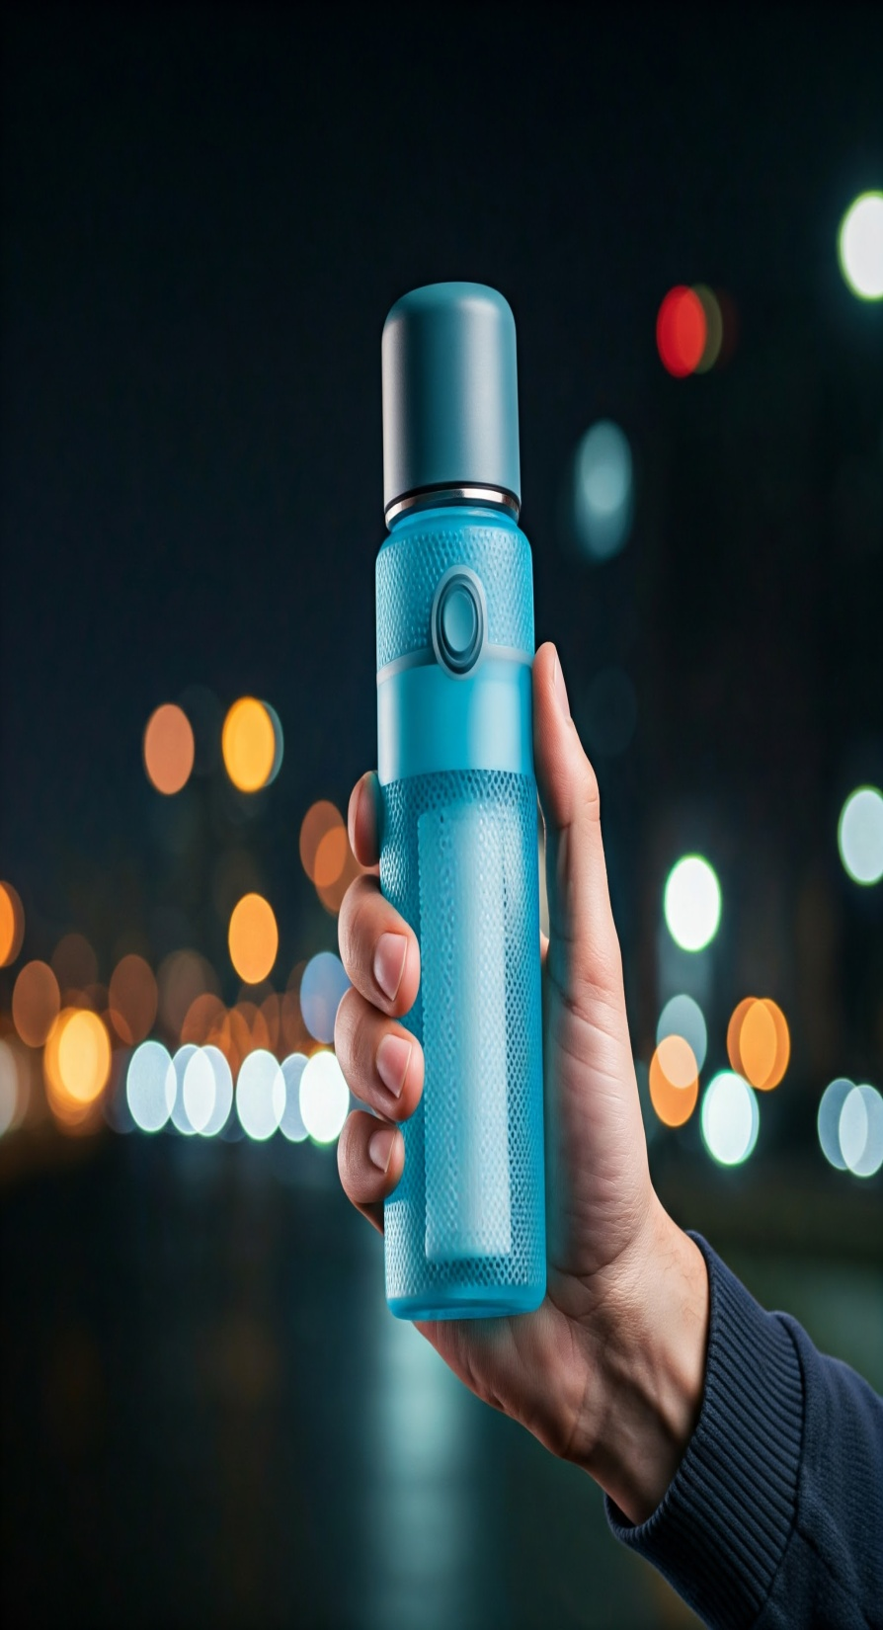
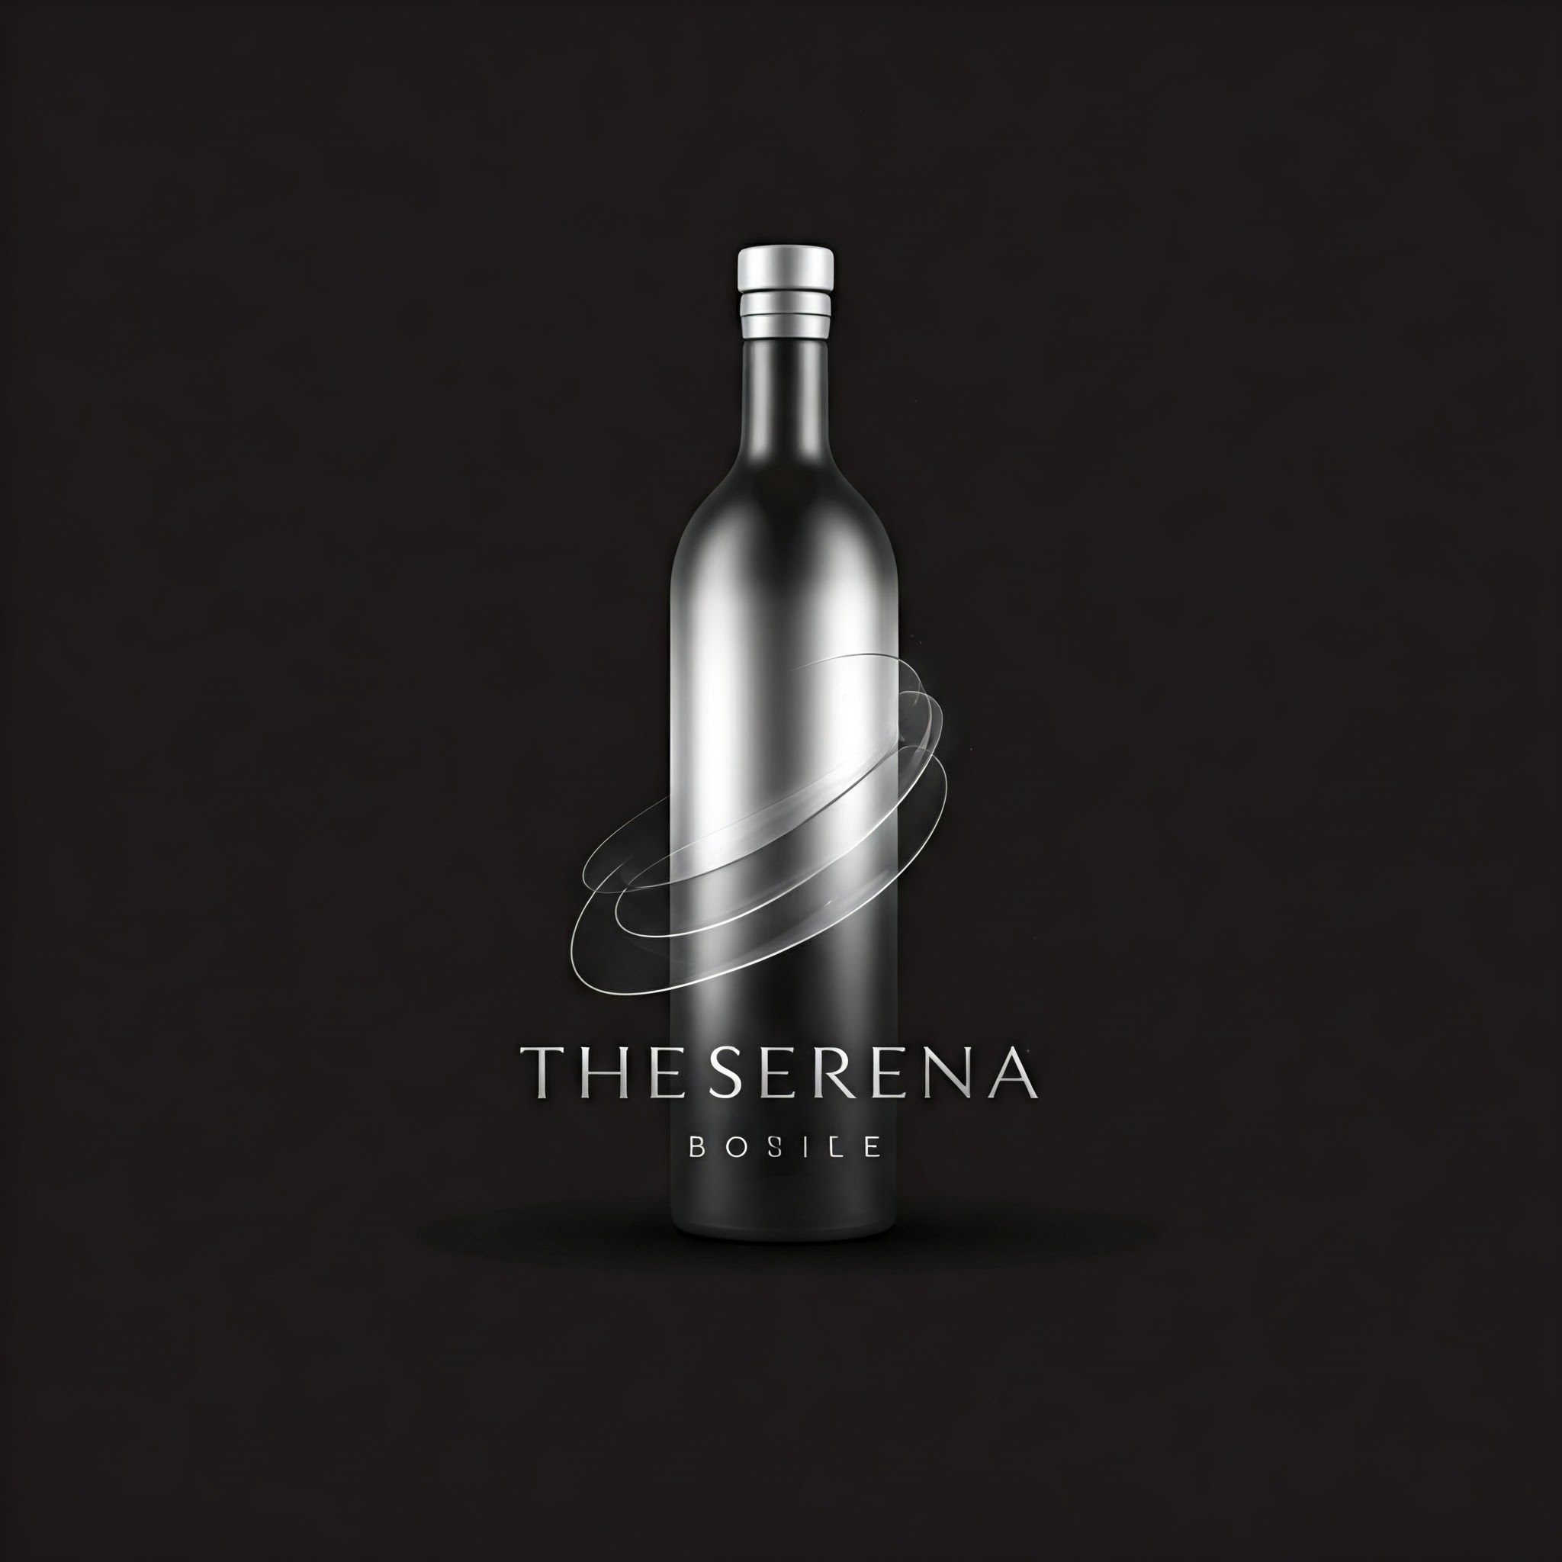
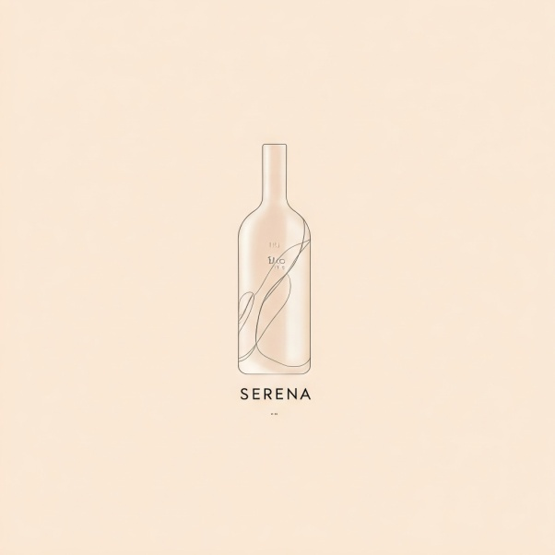
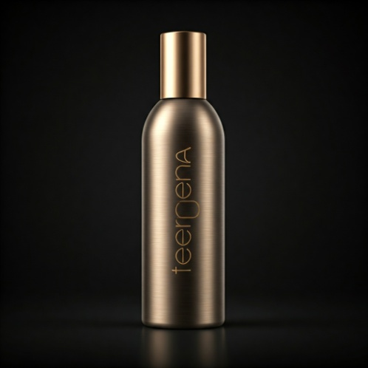
Serena Revolutionizing Hydration
Welcome to Serena: The Future of Water Bottles

Slide 2
Introduction to Serena Revolutionizing Hydration
"In today's fast-paced world, staying hydrated is more important than ever. But traditional water bottles often fall short, lacking innovation and style. That's where Serena comes in."
"Serena is not just another water bottle; it's a hydration revolution. We've combined cutting-edge technology with sleek design to create a bottle that's as smart as it is beautiful."
"Our mission is to make hydration effortless and enjoyable, empowering you to live a healthier, more active life."

Slide 3
Key features and benefits:
Smart Sensor Technology: Track your daily water intake with precision.
Built-in Filter: Enjoy clean, purified water on the go.
Leak-proof Design: Say goodbye to spills and messes.
Sustainable Materials: Our bottles are made from eco-friendly materials.
Sleek and Stylish: Choose from a range of colors and designs to match your personal style

Slide 4
Creativity Meets Market Demand
The global bottled water and luxury bottle market is expected to grow at a CAGR of 7.5% over the next 5 years.
Target market: Affluent, eco-conscious consumers aged 25-45.
The Serena will capture this growing demand for luxury, stylish, and sustainable bottles
Price per Bottle: $20
Units Sold (Year 1): 100,000 bottles
Total Revenue: $2,000,000
COGS per Unit: $8 (Manufacturing + Packaging)
Gross Profit (Year 1): $1,200,000
Operating Expenses: $480,000
Net Profit (Year 1): $720,000

Slide 5
Serena’s Path to Success
Target Market:
Health-conscious individuals: Fitness enthusiasts, athletes, wellness advocates.
Eco-conscious consumers: People seeking sustainable products.
Corporate clients: Custom-branded bottles for companies and events.
Growth Potential:
Capitalizing on the growing eco-friendly and health-conscious market.
Expansion into custom gifting and corporate partnerships.
Brand Vision:
To become the go-to brand for sustainable and innovative hydration solutions.
To lead in creative product design and intelligent technology in the water bottle industry.
Call to Action: Join us in redefining hydration with Serena. Invest in the future of hydration, innovation, and sustainability.

